Slide 1
23/24 Championship Data Analysis
Identifying patterns and trends from the season

Slide 2
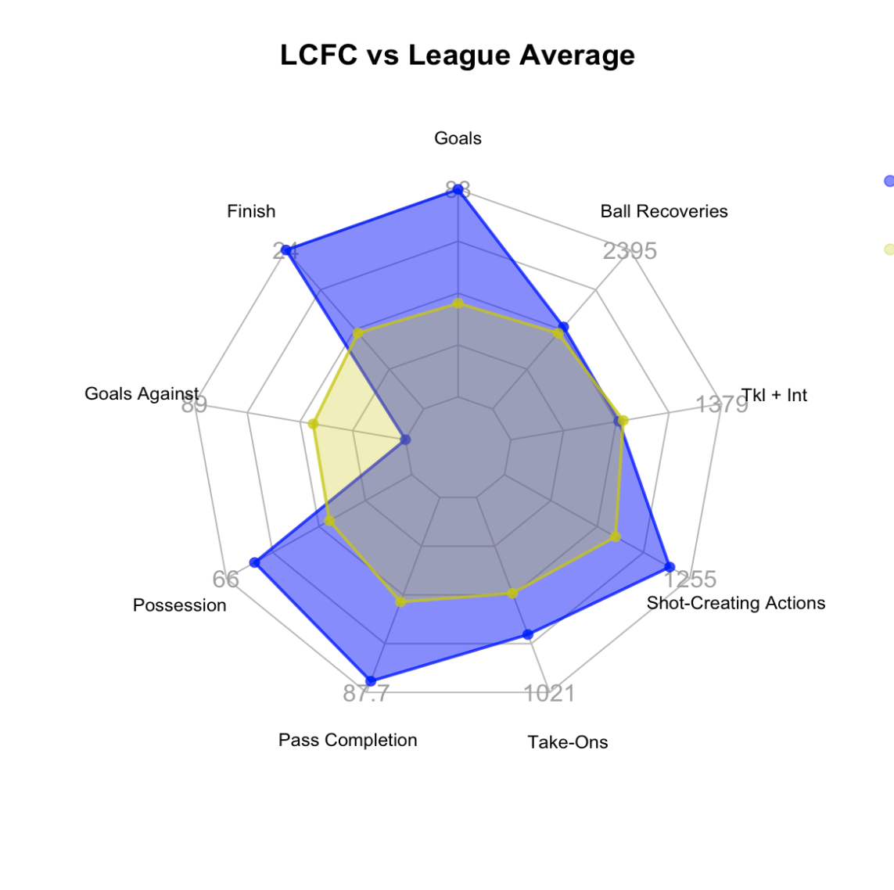
Season Background
Promotion: Leicester City, Ipswich Town, Southampton
Relegation: Birmingham City, Huddersfield Town, Rotherham United
1480 goals
Tight mid-table: only 19 points separated teams between promotion and relegation
Where can these teams improve to make big moves?

Slide 3
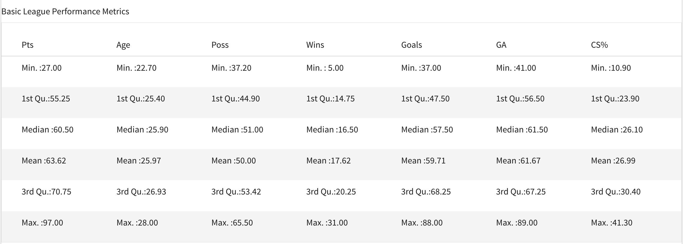
The Data
Aggregated season statistics from Fbref
24 observations, over 200 variables
No variables relating to time
No single game statistics, player data, tracking data, etc.

Slide 4
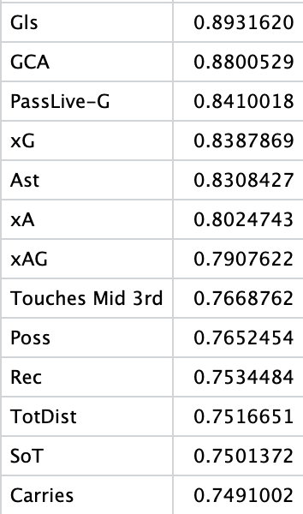
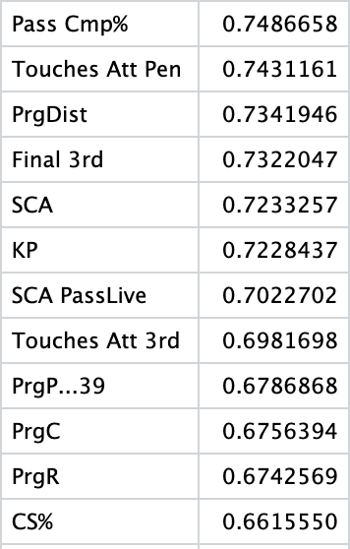
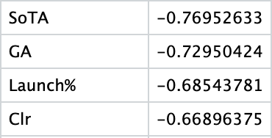
Identifying Key Variables
Checking Correlations with a “Points” variable (measure of success)
Strongest correlated variables: Goals, creation metrics, shots, possession, etc.
Strong Negative Correlation
Strongest Positive Correlation
Strong Positive Correlation

Slide 5
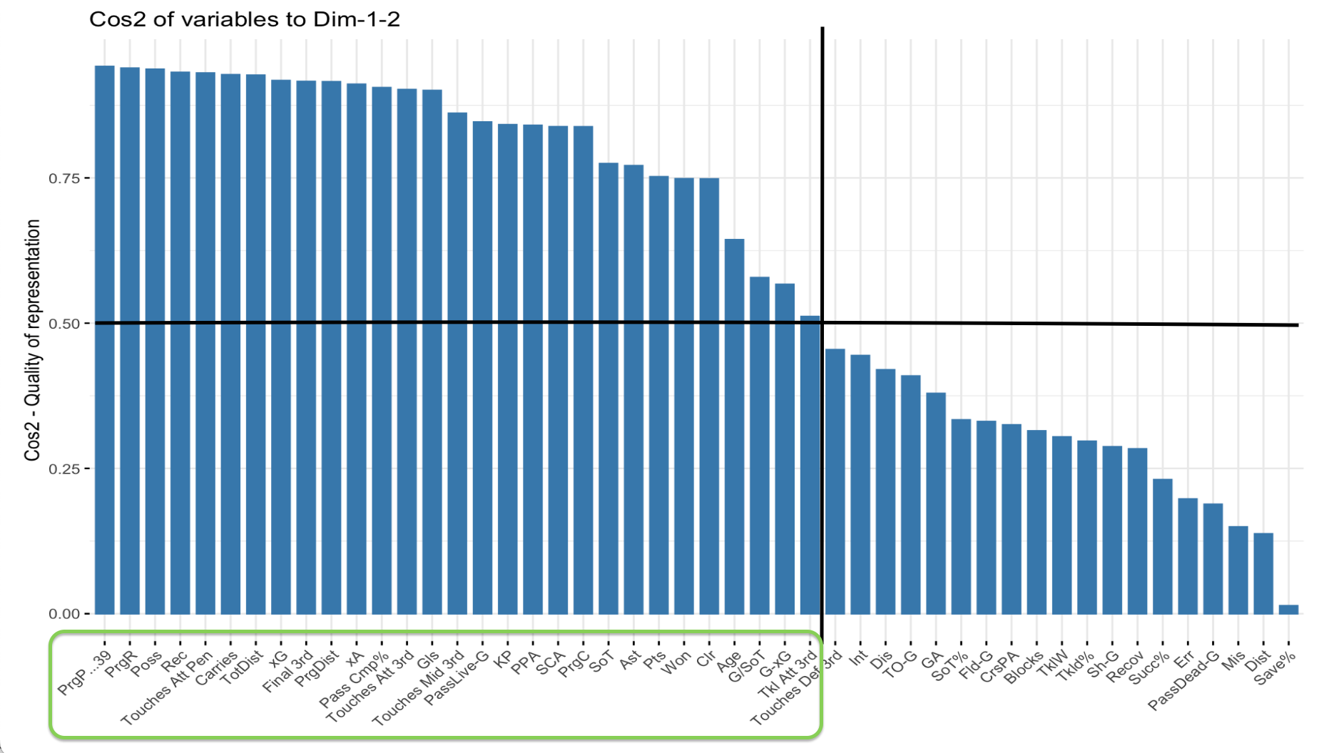
Principle Component Analysis
PCA: method of identifying variable importance
Works well with few observations
Important variable: Cosine value > .5
Important Variables: Progressive Passing, Possession, xG, Pass Completion%, Creation, Tackles Won, etc.
Notes:
2 components were important, these variables were most represented in the two components

Slide 6
What helpful trends in the data can we find using these variables?

Slide 7
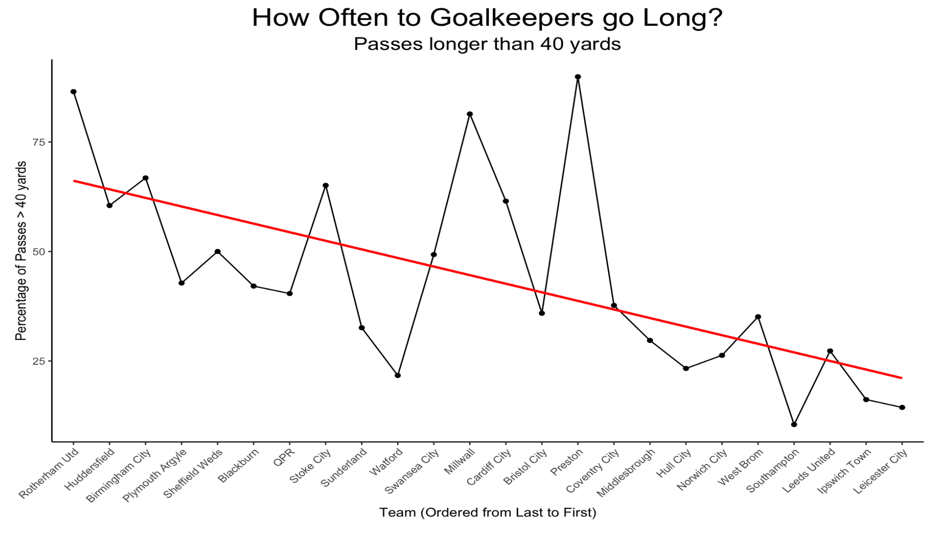
The Modern Defense on Display: GKs
Modern goalkeepers often asked to play passes, start attacks
Some have adapted, some haven’t
Calculated Risk
Notes:
Data Suggests the best teams play from the back often
Negative trend between finishing position, GKs going long

Slide 8
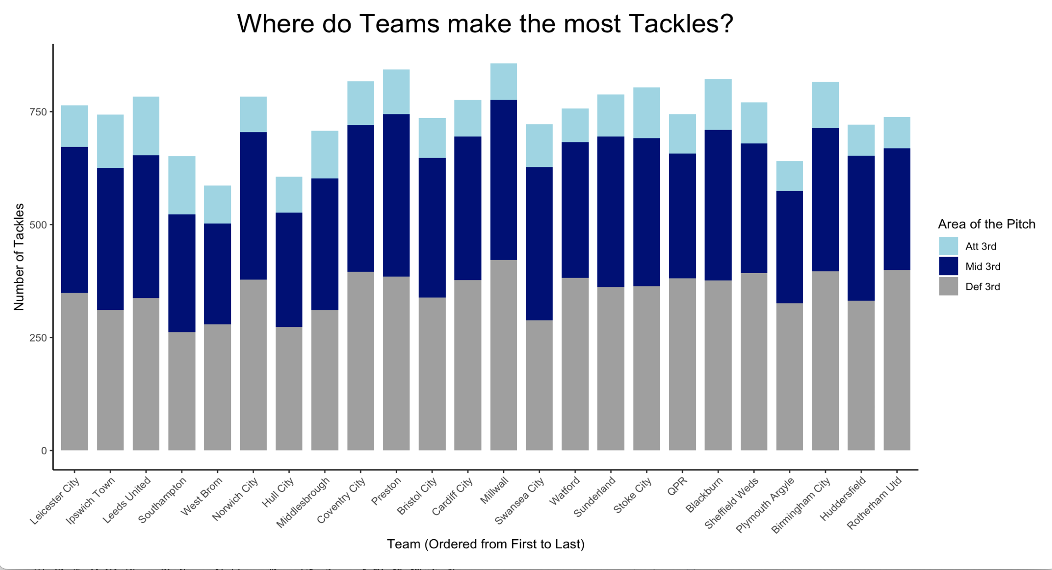
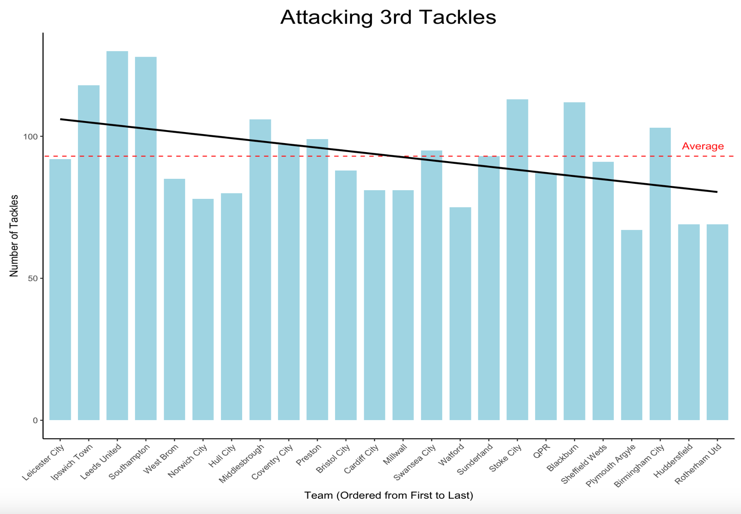
The Modern Day Defense: Pressing
Notes:
Not much to tell from total tackles, no real trend
Looking at just attacking 3rd tackles, 7 of top 10 are above / average for attacking 3rd tackles, defending from the front is part of the modern game
Flip side to building from the back, good teams press, win the ball high up the field for dangerous possession

Slide 9
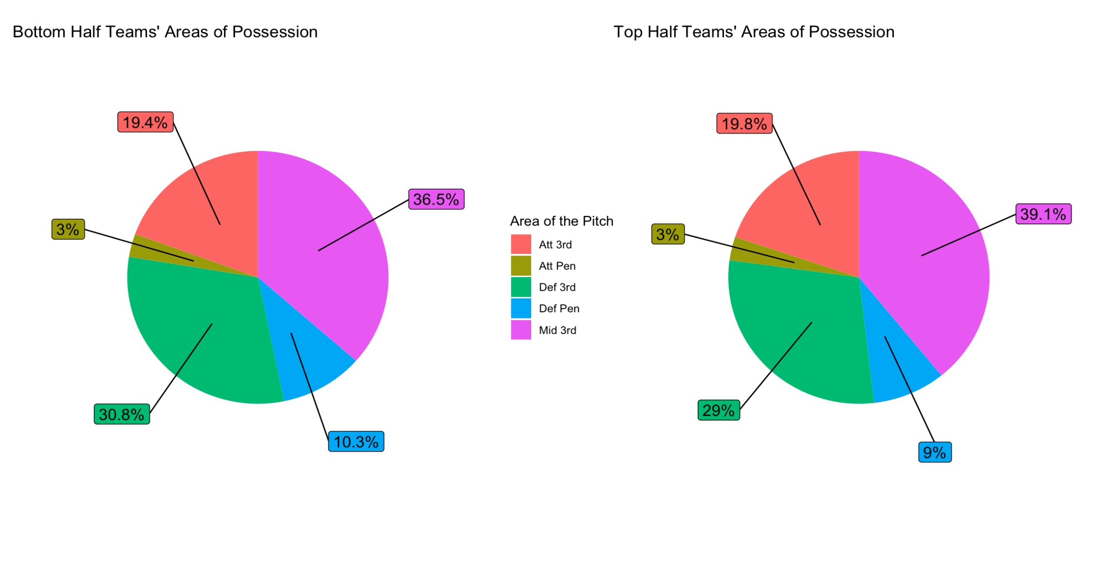
Possession Providing Control
Modern teams look to control the ball
Control = All areas
Notes:
Graphs are basically the same → no difference in possession areas
Differences lie in total touches: 30k on average for top half teams to 25k for bottom
Indicates that dominance is control of every area of the pitch.

Slide 10
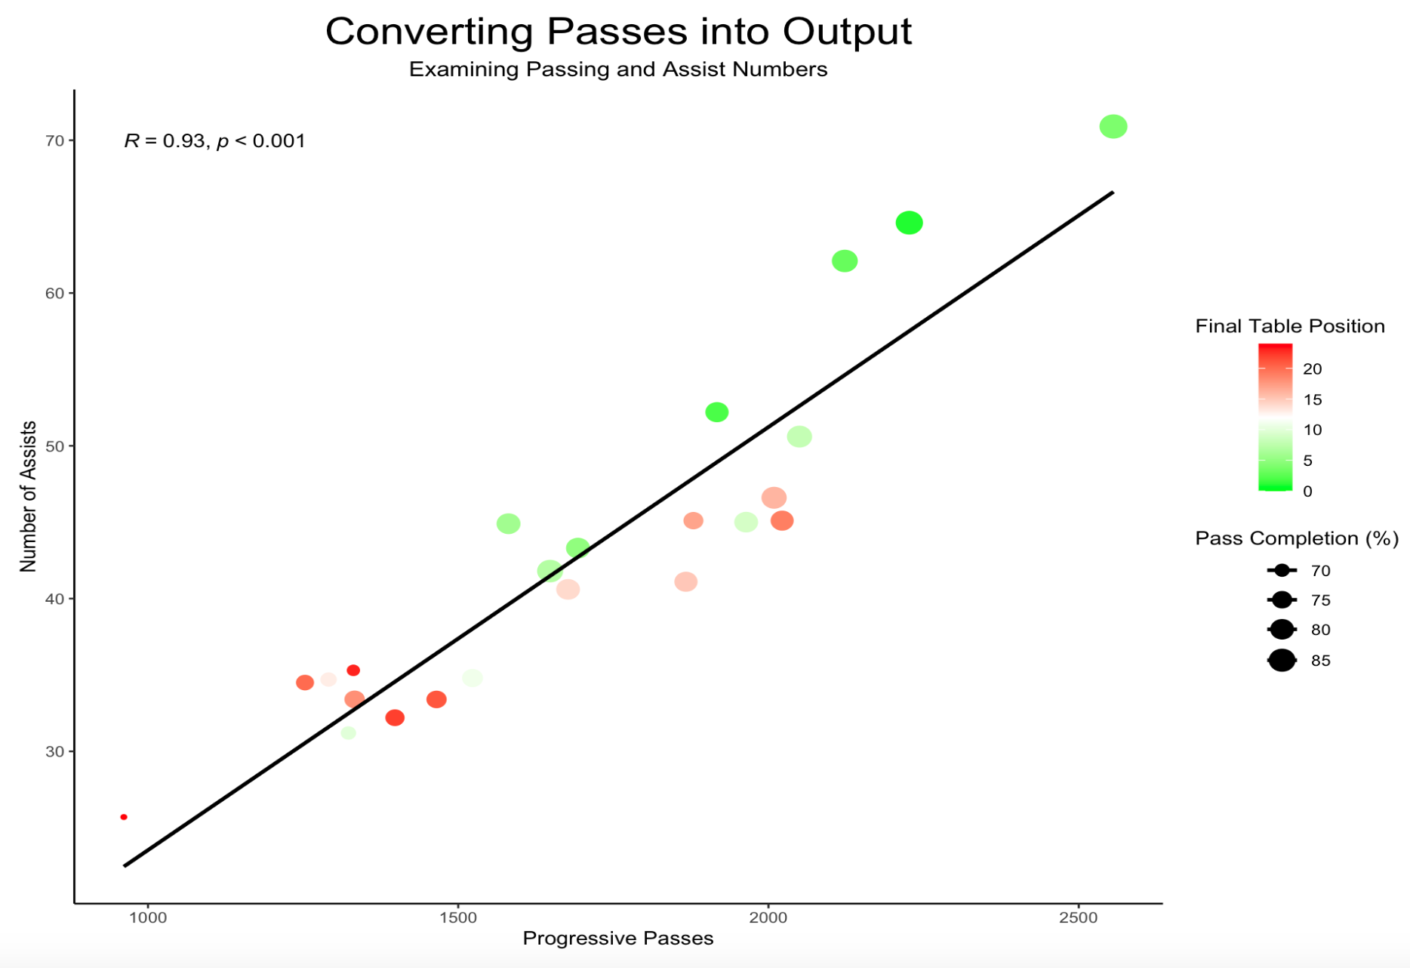
Possession Into Output
Possession means nothing if you can’t convert it into output
Intricate, forward-thinking teams lead the pack
Notes:
Make sure to explain the legends
Strong positive correlation between Progressive passing and Assists (output)
Teams at the top of table are more efficient in general at converting progressive passes to assists,
more passes / possession = goals

Slide 11
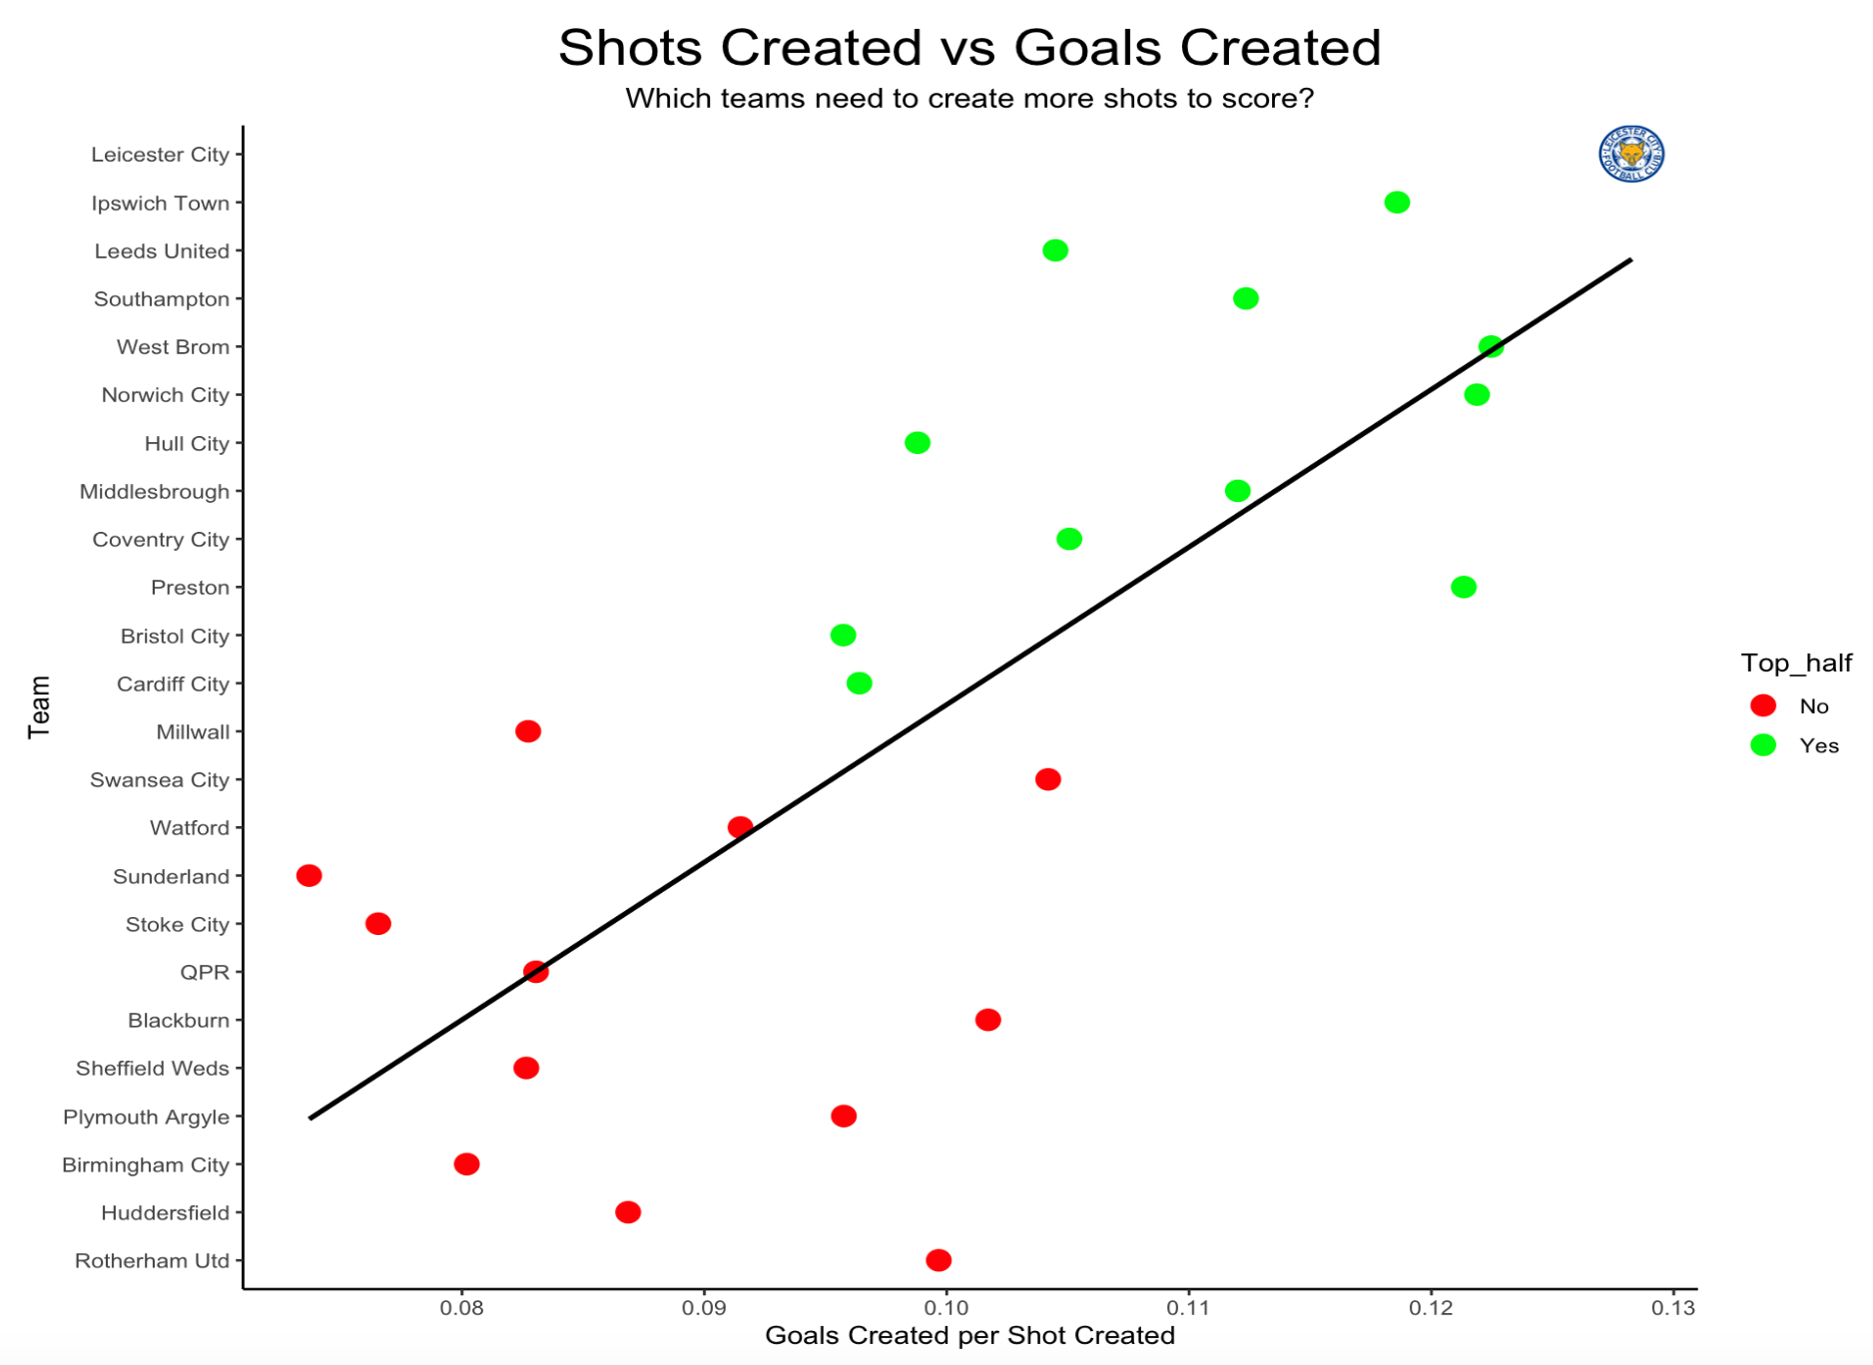
Chance Creation: Efficiency is Key
Goals are scored with shots
Creating shots is difficult → must be efficient with chances
Notes:
GCA per SCA measures how efficiently teams turn there chances into goals
Top teams are almost all above there bottom half counterparts when it comes to this metric
Efficiency is KEY!!!

Slide 12
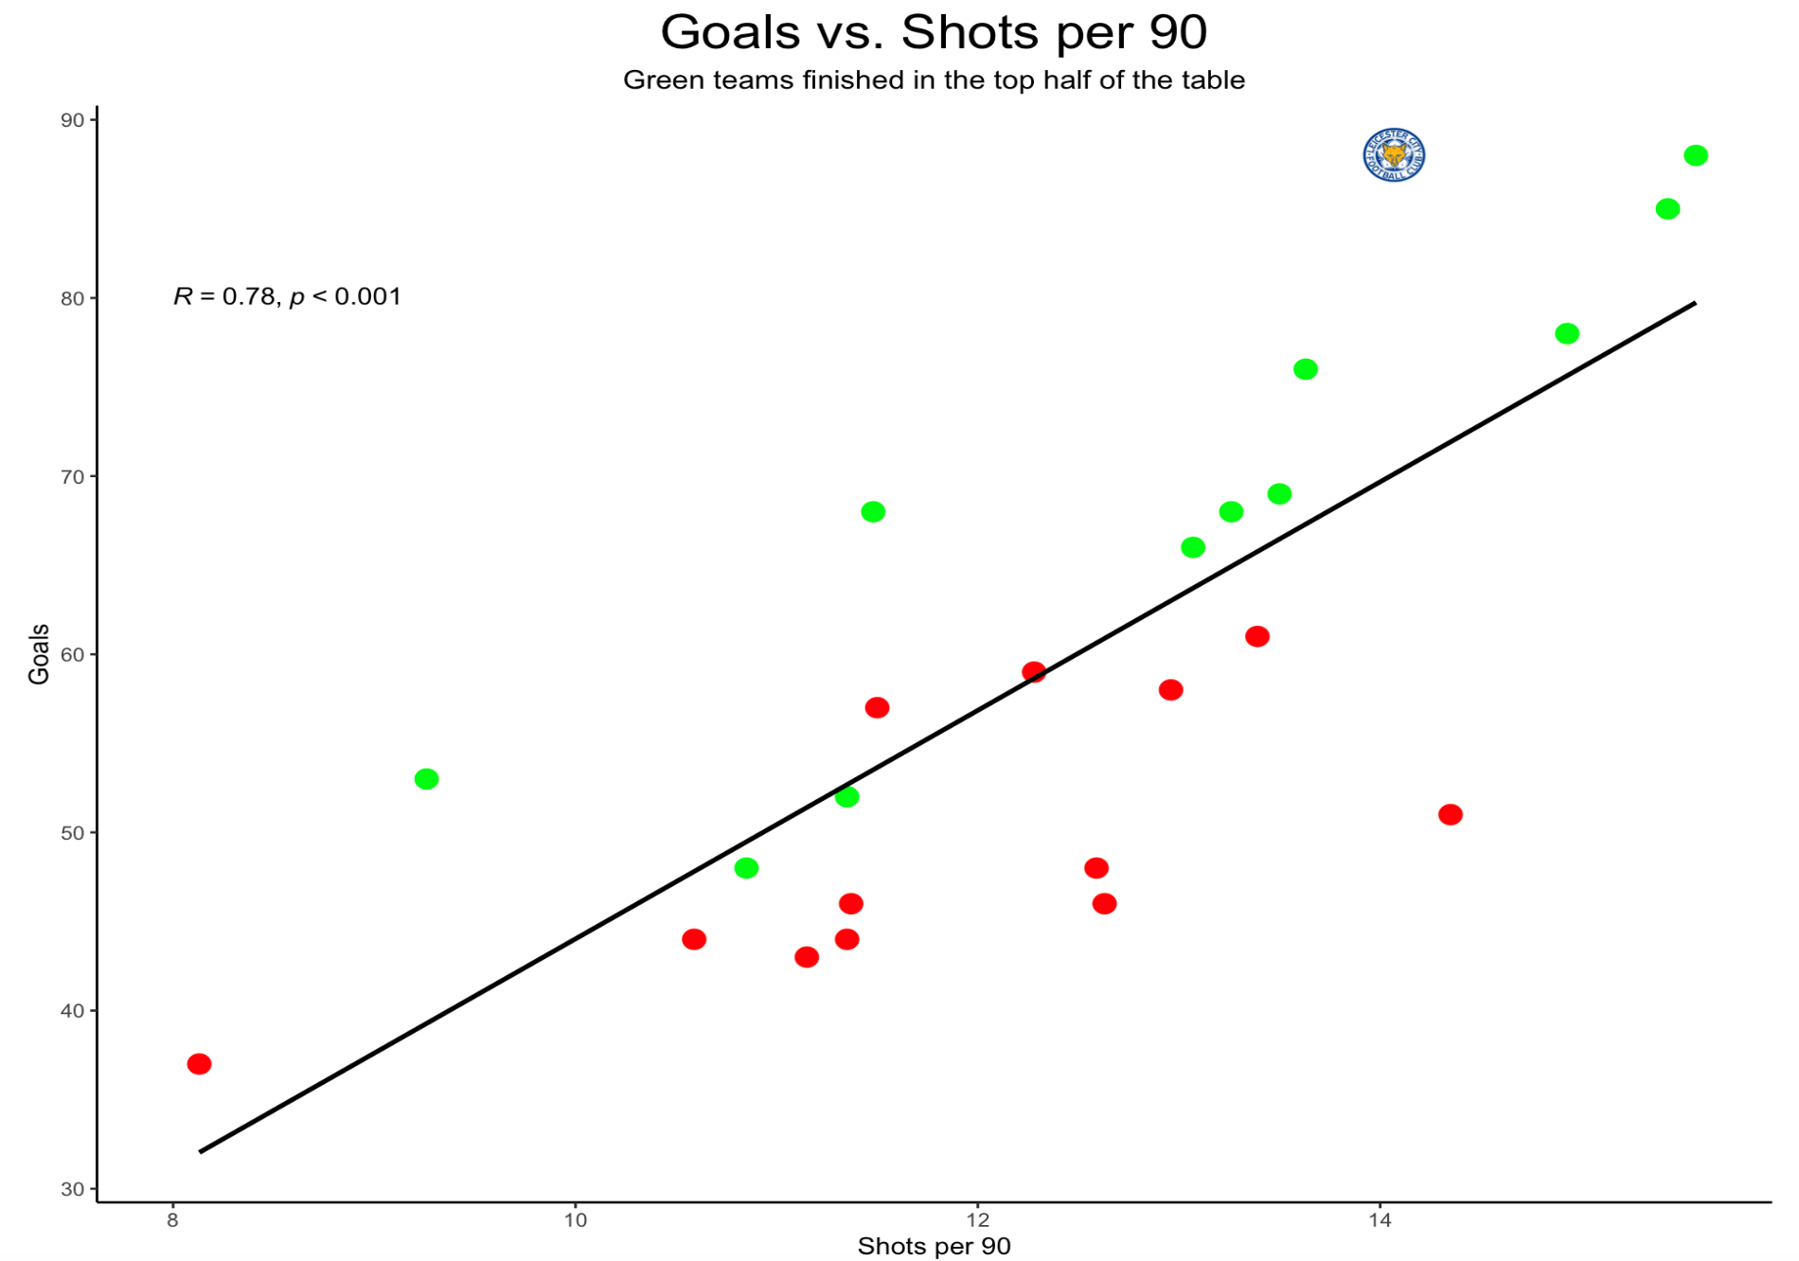
Moneyball Metric
Shots = Moneyball metric
Efficiency still key
Notes:
Top half teams may not have all finished with more shots, but they were more efficient, above the trendline

Slide 13
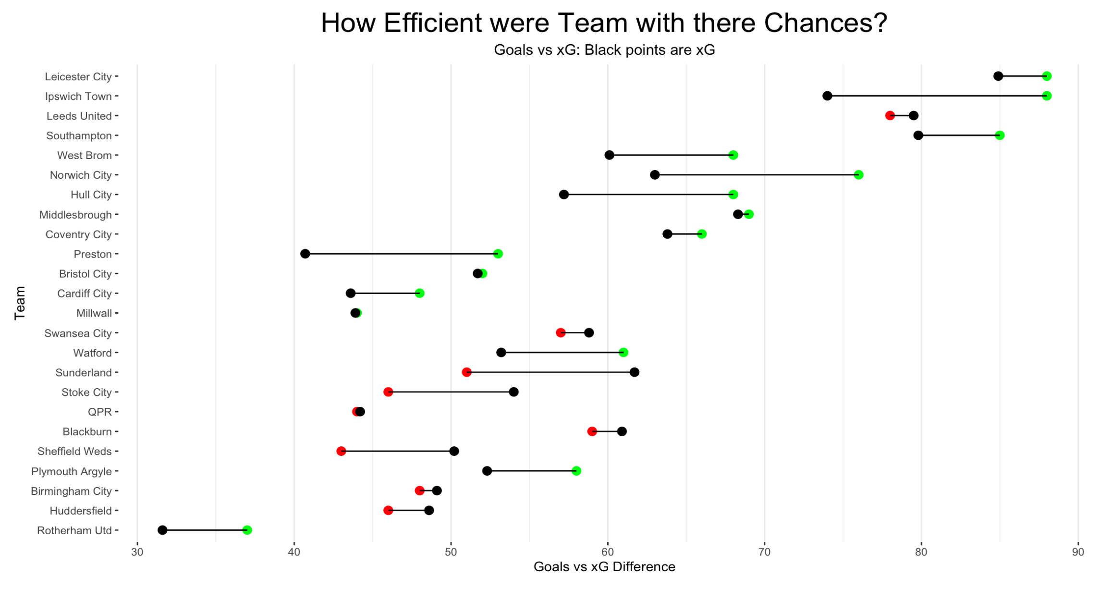
Scoring Goals: The Name of the Game
Can’t win if you don’t score, can’t score if you can’t finish
xG and xPoints are big indicators of success in the long run
Notes:
Once again, bottom teams are less efficient
Sunderland were the biggest underachievers, xG under performance resulting in a point total that was 14 points less than their expected total, Stoke was 6. Leicester exceeded there xPoints total by 10, Ipswich by 15, both leading to automatic promotion due to efficient goal scoring

Slide 14
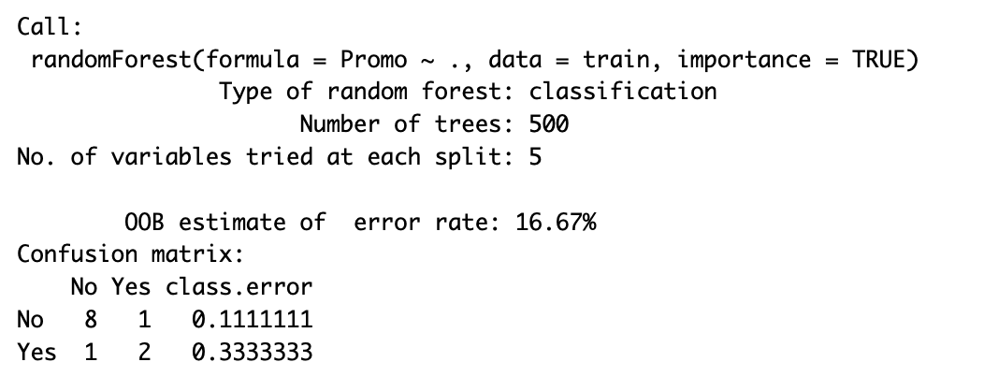
Championship Objective: Promotion
Random Forest model to try and predict promotion
Using important variables determined earlier
RF good with few observations
Limitations
Low error rate
Notes:
RF model has bootstrapping built in to account for the low number of observations
Variables used include the important variables from earlier and the ones I looked at
17% error rate is fairly low considering the data limitations
Suggests that mastering these variables examined leads to better performance and a chance at promotion

Slide 15
Conclusions
Championship is one of the most competitive leagues in the world
Modern football has the edge
Ways to get ahead
Control of all areas of the pitch
Establish a press
Build from the back, think forward
Efficiency in the final third

